Slide 1
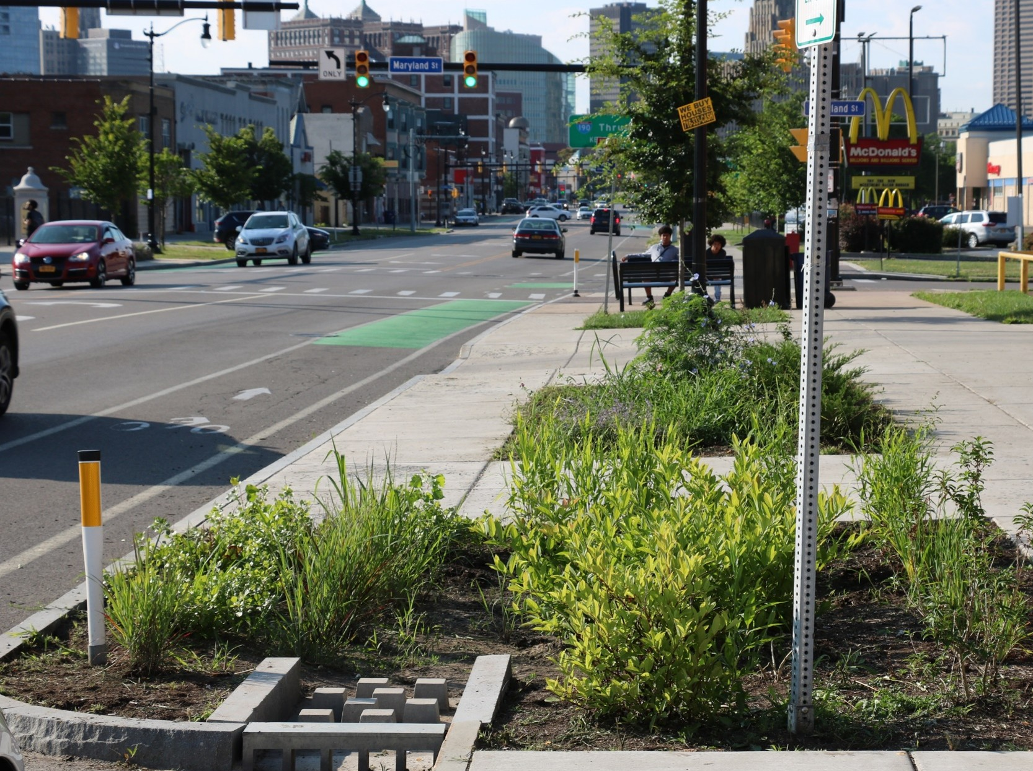



BSA GSI Program
BSA GSI Project Team:
AKRF | Atlantic Testing Laboratories | Arcadis | CME Associates | Hallmark Planning | JM Davidson Engineering | KHEOPS Architecture, Engineering and Surveying | Nussbaumer & Clarke, Inc. | Ravi Engineering and Land Surveying | True North Land Surveying | Watts Architecture and Engineering | Wendel Companies | WM Schutt & Associates
1

Slide 2





GREEN INFRASTRUCTURE
OWNER
Stephanie Alessandrini, PE
Program Manager
Ella Austin
Program Management Support
Rosaleen Nogle, PE, BCEE
Principal Sanitary Engineer

Slide 3

Program History

Slide 4
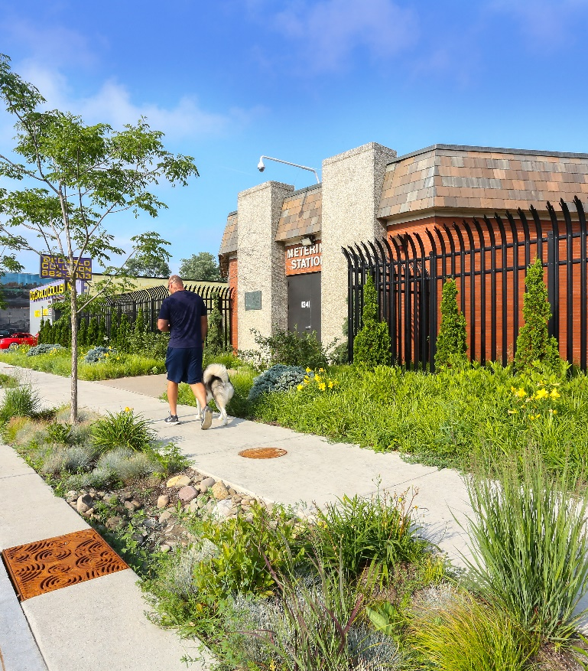
RainCheck 2.0 Program Overview
Raincheck Program: Protect & restore Buffalo’s waterways through GSI implementation
Environmental Impact Bond (EIB): $54 million for GSI
  Manage 200 acres of impervious area through green infrastructure by 2028
Notes:
Raincheck Program: Protect & restore Buffalo’s waterways
BSA’s overall goal is to manage 569 acres of impervious area by 2034
Raincheck 2.0 (Current Phase of Green Stormwater Infrastructure Program)—Public partnerships & public streets
Raincheck 2.0 targets 6 priority CSO basins
Environmental Impact Bond (EIB): $54 million for GSI
Manage 200 acres of impervious area through green infrastructure by 2028

Slide 5
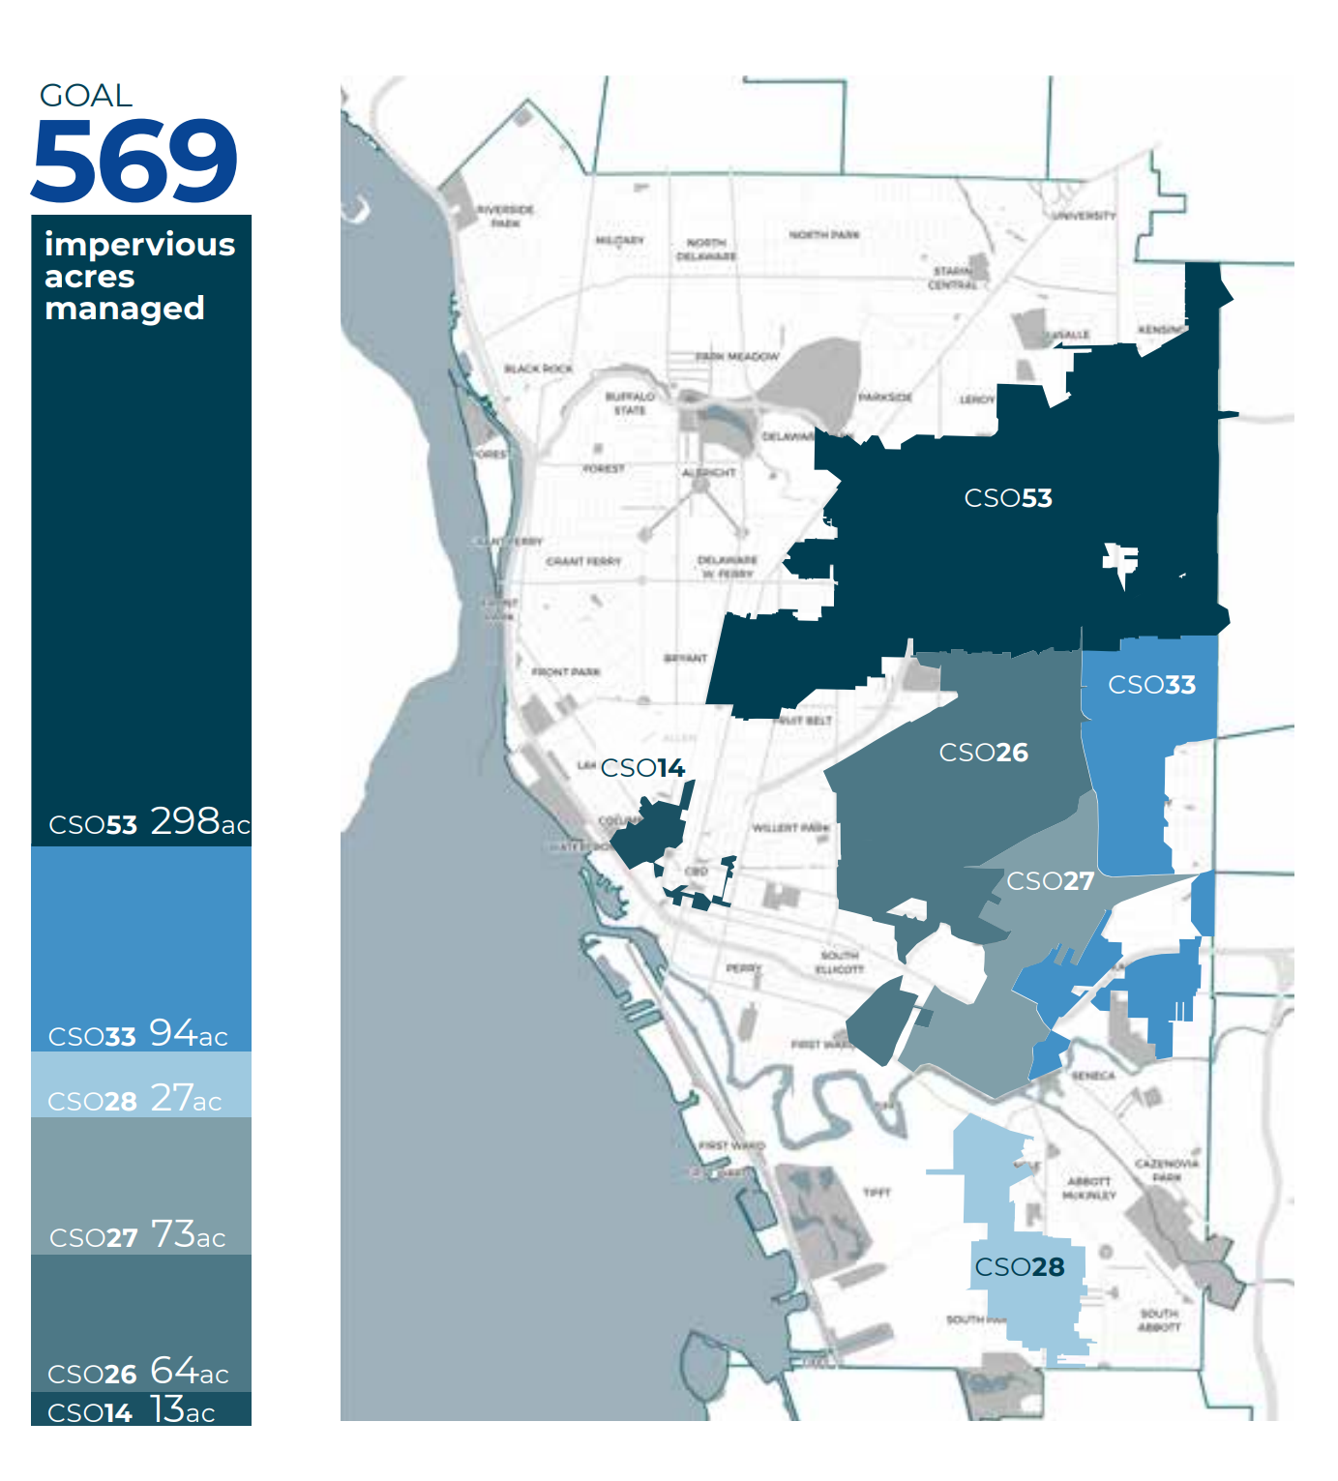
Priority Basins
The six priority basins are located across Buffalo’s East Side, in Downtown Buffalo and in South Buffalo.
They encompass 25% of the city’s land area and nearly half of the city’s population
Areas of greatest impact on number of combined sewer overflow events.
Notes:
The six priority basins identified for implementing GSI in the RainCheck 2.0 program are located across Buffalo’s East Side, in Downtown Buffalo and in South Buffalo.
They encompass 25% of the city’s land area and nearly half of the city’s population
They were chosen to have the greatest impact on water quality and public health in Buffalo by improving basins with high numbers of combined sewer overflow events.

Slide 6
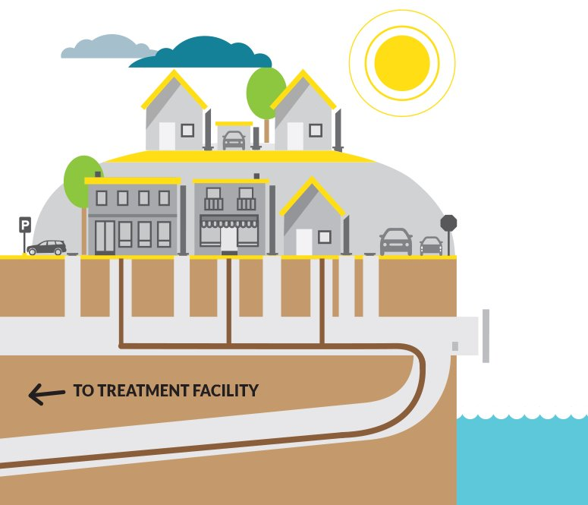
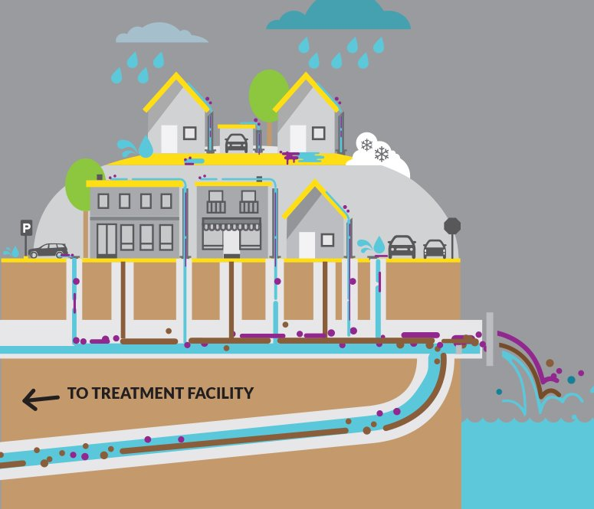
Combined Sewer Overflows (CSOs)

Slide 7

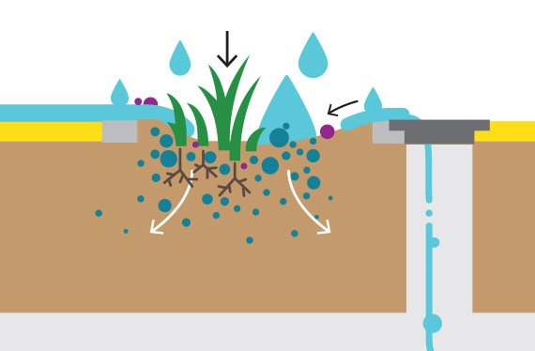
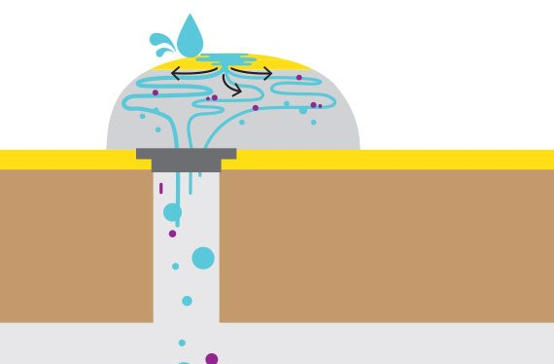
Why Green Stormwater Infrastructure
Green Stormwater Infrastructure is designed to mimic nature by managing stormwater where it falls.

Slide 8
Raincheck 2.0 Program Timeline
2019
2024
Winter/Spring 2026
Design continues
Hennepin Park issued for bid
2027
Rain Check 2.0
Six Priority Combined Sewer Basins Identified
GSI Planning phase
Awarded $8.75M through Green Resiliency Grant
Construction
2004-2014
2021
2025
Summer/ Fall 2026
2028
Development and approval of BSA Long-Term Control Plan
$54M in funding through EIB
Survey & Geotechnical investigations and design kick off
Awarded $10M through Green Resiliency Grant
Funding and Construction Deadline for EIB
Construction begins (Hennepin Park)
Anticipated end of design phase

Slide 9
Program Packages

Slide 10
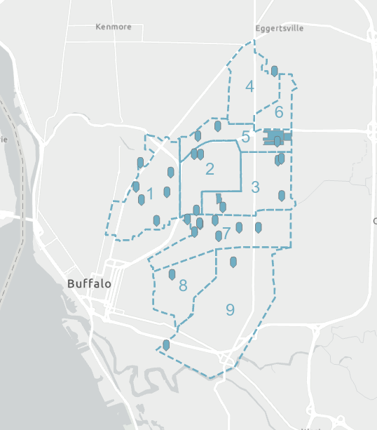
Program Packages
Planning phase identified approx. 550 GSI practices across the priority basins to manage 200+ acres of impervious area
Practices are split into 14 packages:
  Practices are located within the right-of-way, on 19 Buffalo Public School (BPS) properties, 2 Buffalo Municipal Housing Authority (BMHA) sites, and 9 City Park properties
BPS, BMHA, and Parks Packages are indicated by pins and shaded areas

Slide 11
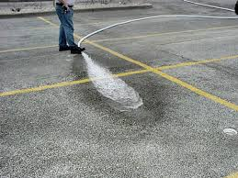
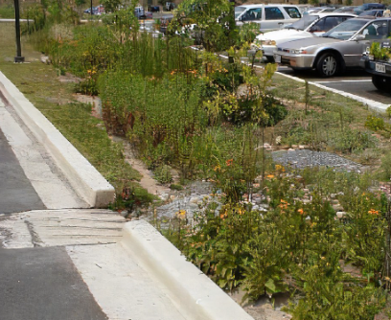
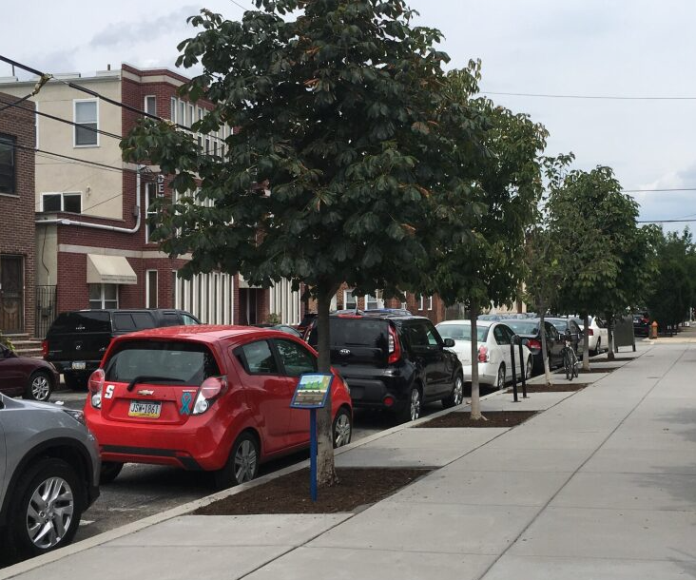
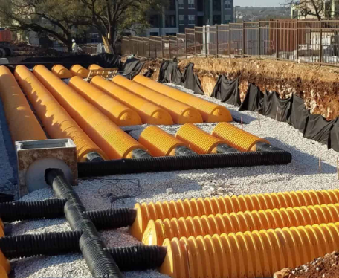
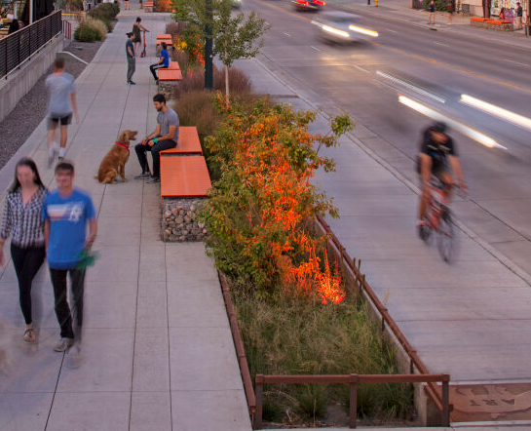
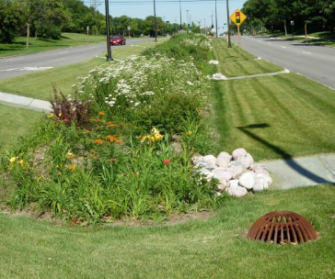
Green Stormwater Infrastructure
Porous Pavement
Underground Storage
Rain Gardens/Bioretention
Stormwater Planter
Stormwater Tree Trench
Bioswale

Slide 12
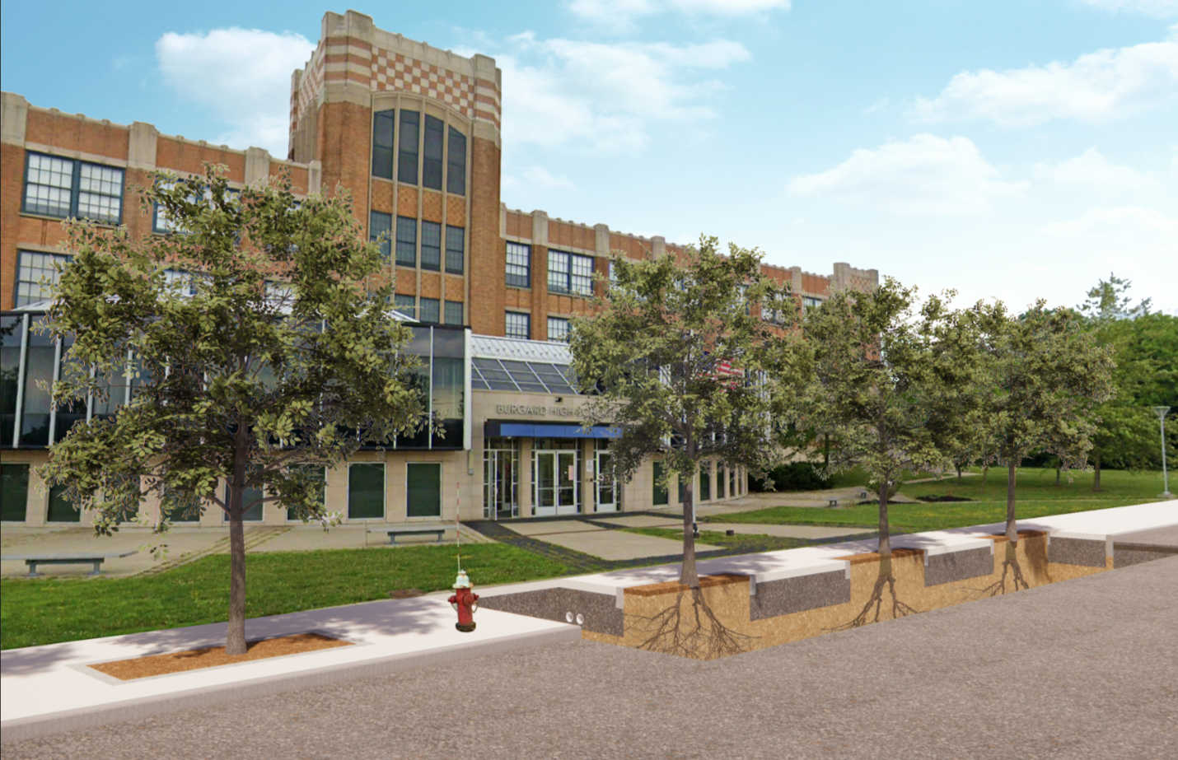
RainCheck Stormwater Tree Trenches

Slide 13
RainCheck Stormwater Tree Trenches

Slide 14
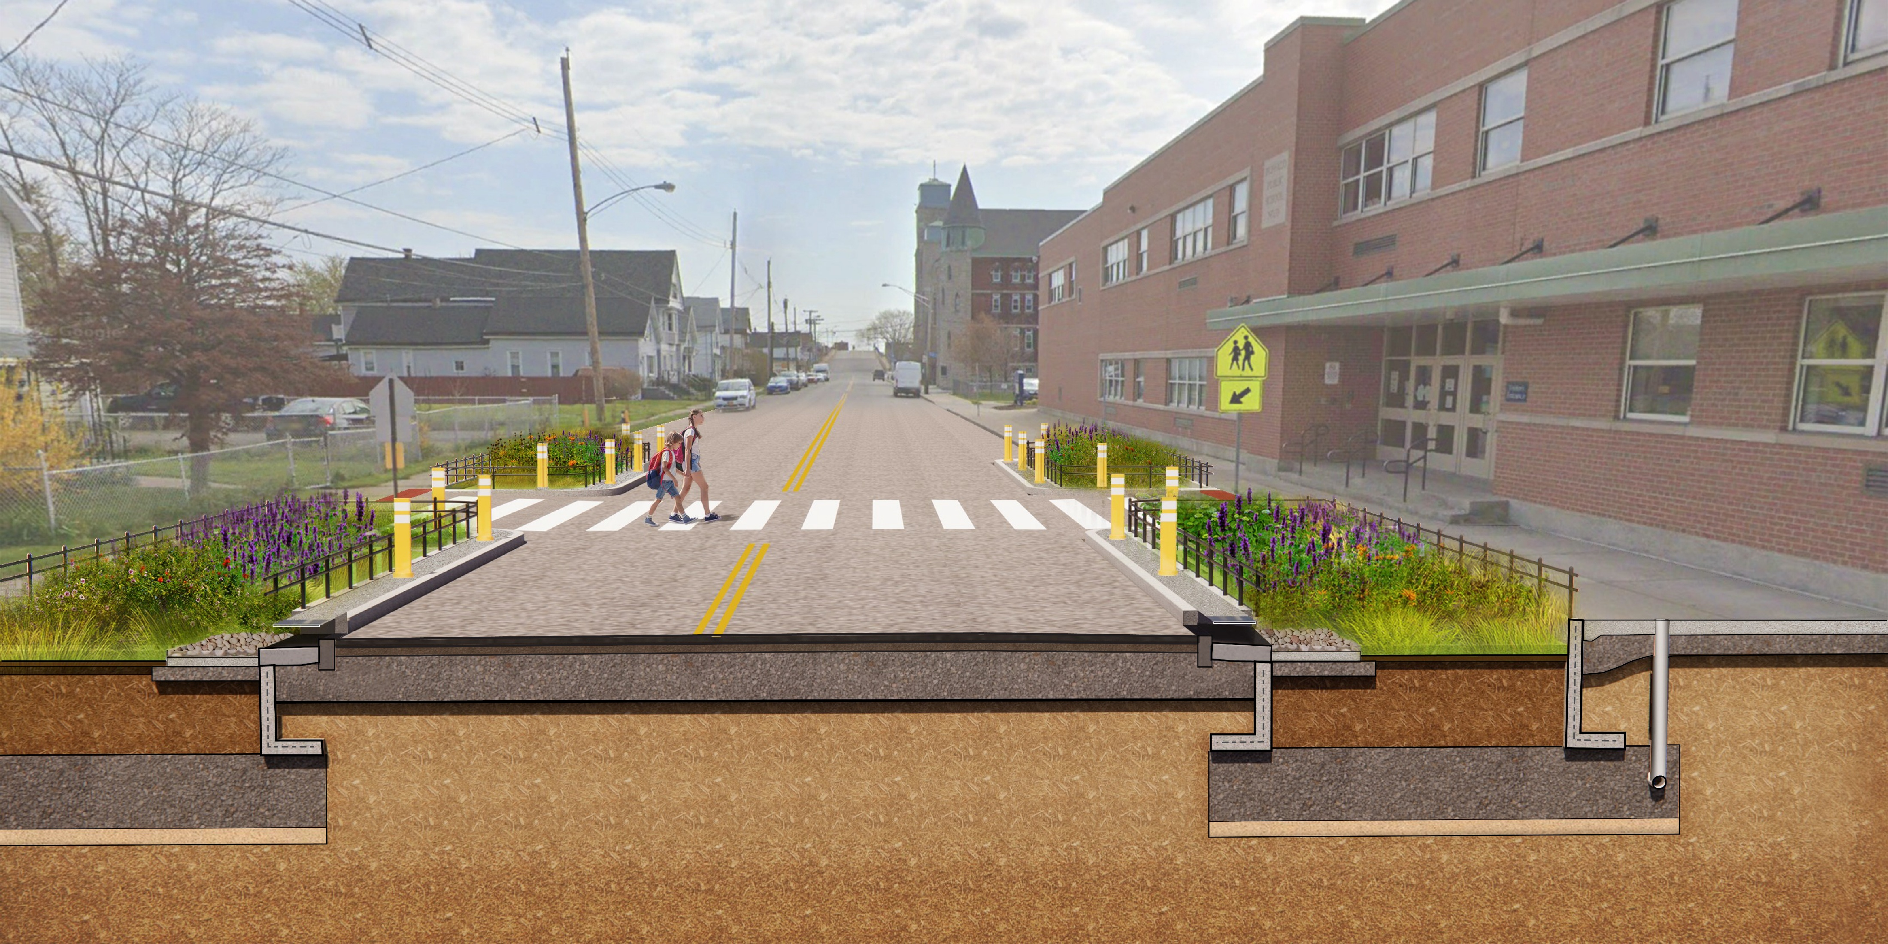
RainCheck Stormwater Planters

Slide 15
RainCheck Stormwater Planters

Slide 16
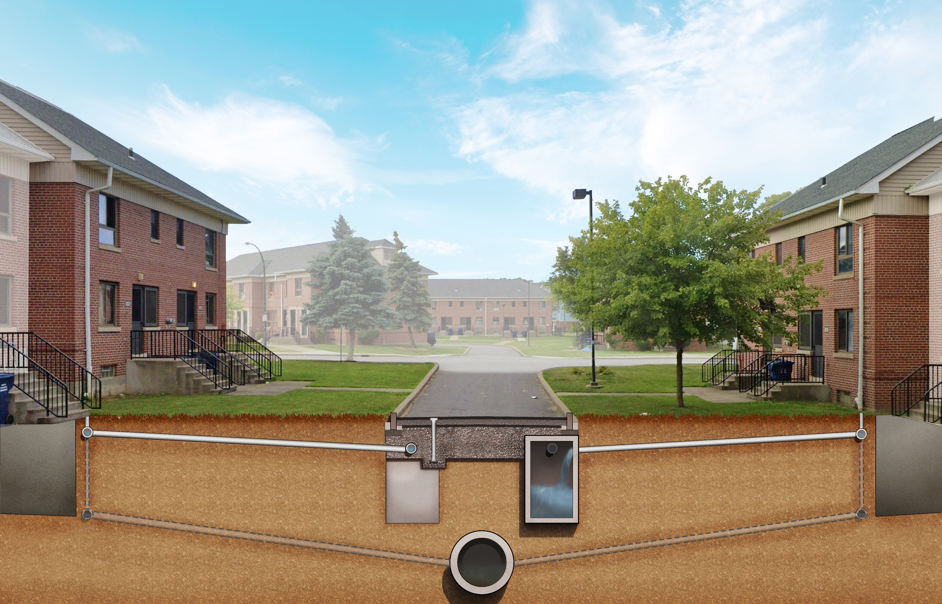
RainCheck Porous Pavement

Slide 17
RainCheck Porous Pavement

Slide 18
PACKAGE NAME | LOCATION (WITHIN THE RIGHT-OF-WAY) | NUMBER OF IMPROVEMENTS | OPINION OF PROBABLE CONSTRUCTION COST
Package 1 | Masten Park, Hamlin Park, Parkside neighborhoods | 61 | $5-10M
Package 2 | Delavan Grider, MLK Park neighborhoods | 48 | $3-5M
Package 3 | Schiller Park, Genesee-Moselle, MLK Park, Kenfield neighborhoods | 61 | $5-10M
Package 4 | University Heights, Kensington-Bailey neighborhoods | 43 | $3-5M
Package 5 | Fillmore-Leroy, Kensington-Bailey, Kenfield neighborhoods | 60 | $3-5M
Package 6 | Kensington-Bailey neighborhood | 49 | $3-5M
Package 7 | Broadway Fillmore, MLK Park, Genesee-Moselle, Schiller Park neighborhoods | 50 | $3-5M
Package 8 | Broadway Fillmore neighborhood | 49 | $5-10M
Package 9 | Lovejoy, Broadway Fillmore, Seneca Babcock neighborhoods | 43 | $3-5M

Slide 19
PACKAGE NAME | LOCATION (WITHIN THE RIGHT-OF-WAY OR CITY-OWNED PROPERTY) | NUMBER OF IMPROVEMENTS | OPINION OF PROBABLE CONSTRUCTION COST
Parks Package 1 | Hennepin Park | 1 | $3-5M
Parks Package 2 | MLK Jr. Park, Genesee Gateway, Eddie Dawson Park, Lincoln Playground | 10 | $1-2M
Parks Package 3 | Schiller Park, Glenny Park, Hank Nowak Park, Mary Jean Sloan Park | 9 | $1-2M
BPS Package | 19x Buffalo Public School Properties | 60 | $5-10M
BMHA Package | Ferry Grider, Kenfield & Langfield Buffalo Municipal Housing Authority sites | 26 | $10-15M

Slide 20
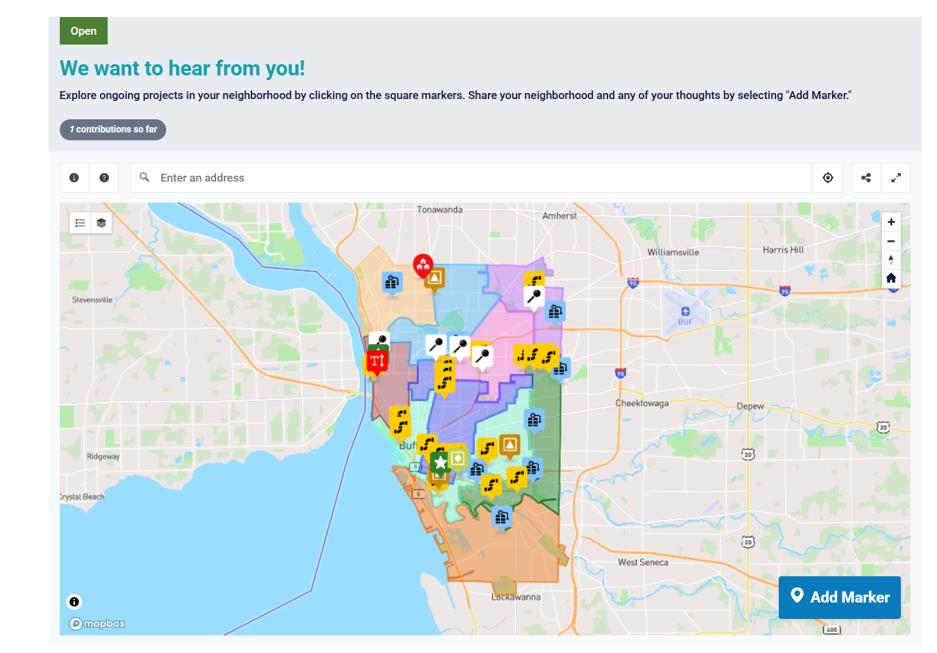
Public Web App
WORK IN PROGRESS

Slide 21



Thank you!
@BuffaloSewer
BuffaloSewer.org
@BuffaloSewer
BuffaloSewerAuthority

